Slide 1
Spam Email Detection
Anna Nardelli

Slide 2
Introduction
Spam email detection is an important topic to be analyzed in machine learning
Machine learning can identify patterns in data that cannot easily be seen
The goal of the project is to be able to identify whether an email is spam or not based on the frequency of words used

Slide 3
Methods
Dataset - Email Spam Classification, Kaggle, 5172 instances, 3000 columns
Algorithms Discussed
K-Nearest Neighbors
Logistic Regression
Perceptron
Analysis of algorithms using GridSearchCV to find the best parameters for K-Nearest Neighbors and Logistic Regression

Slide 4
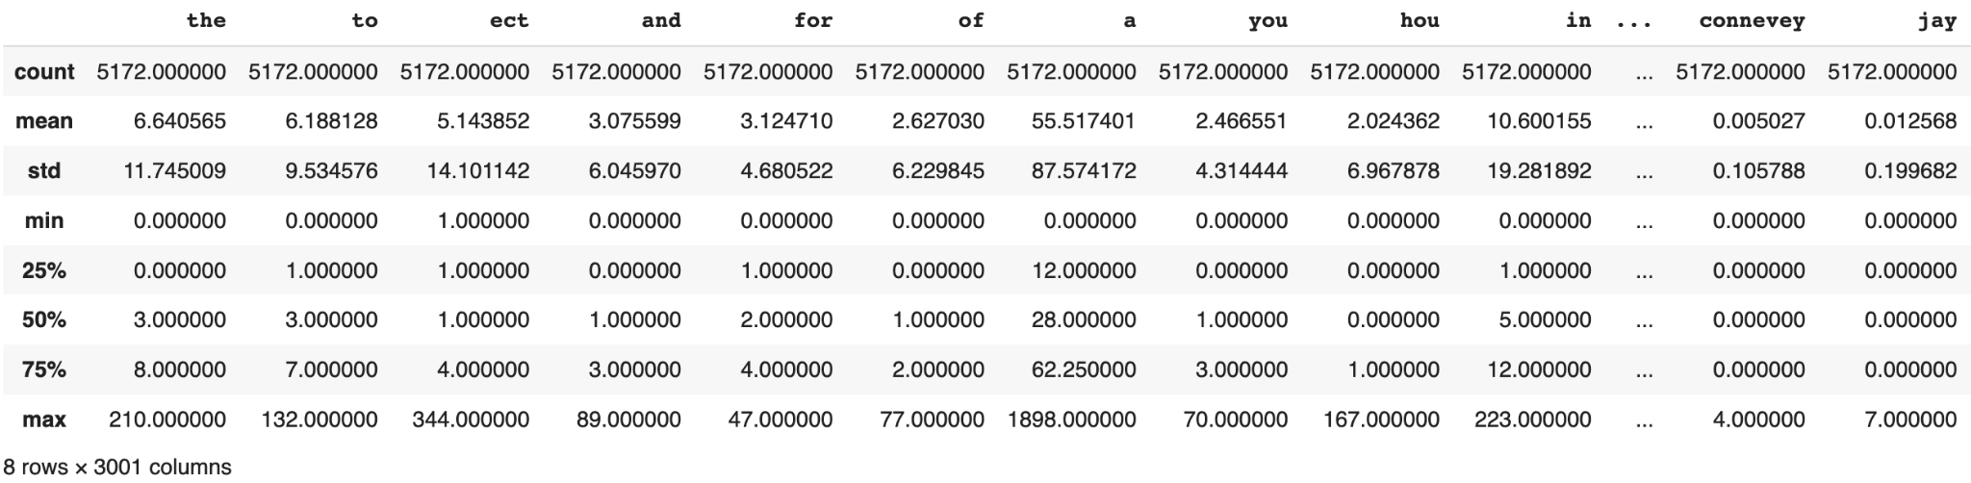
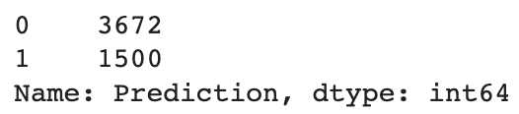
Dataset describe() and value_count() methods

Slide 5
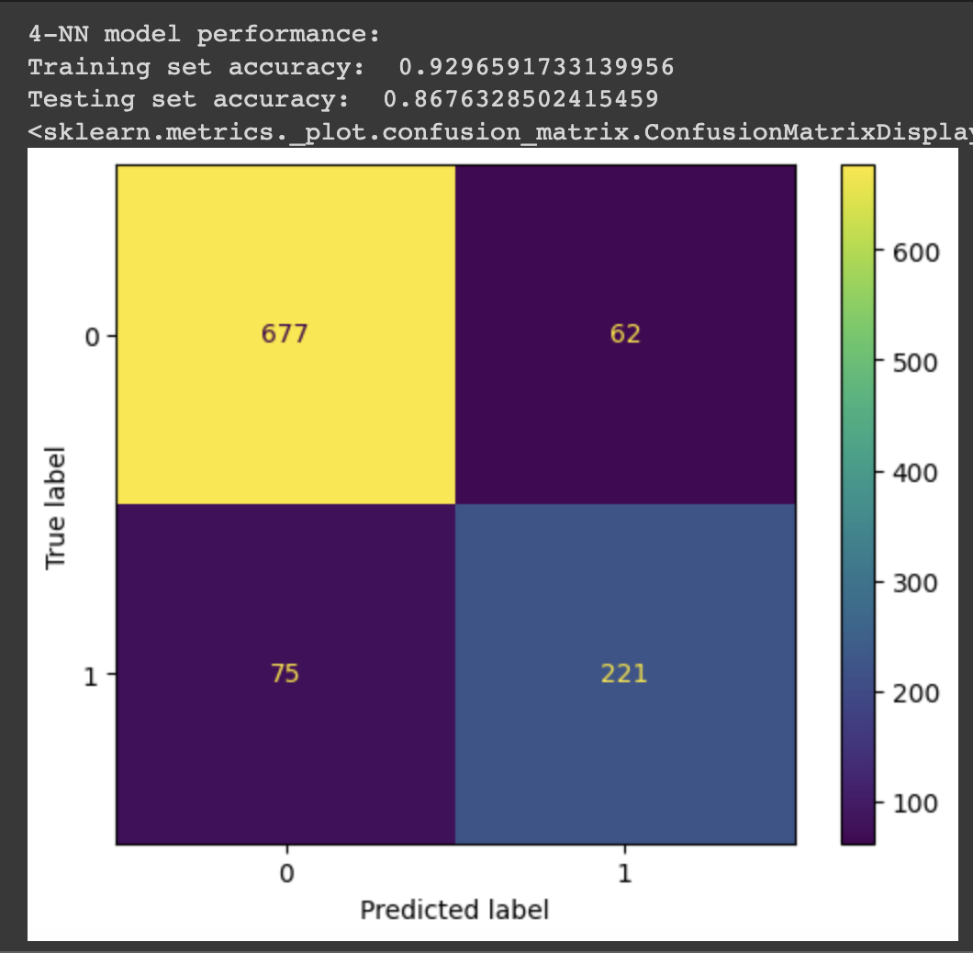
Results
K-Nearest Neighbors
4-NN gets highest training accuracy
Very overfitted
Training set accuracy: 0.93
Testing set accuracy: 0.87
Not the best results of the group

Slide 6

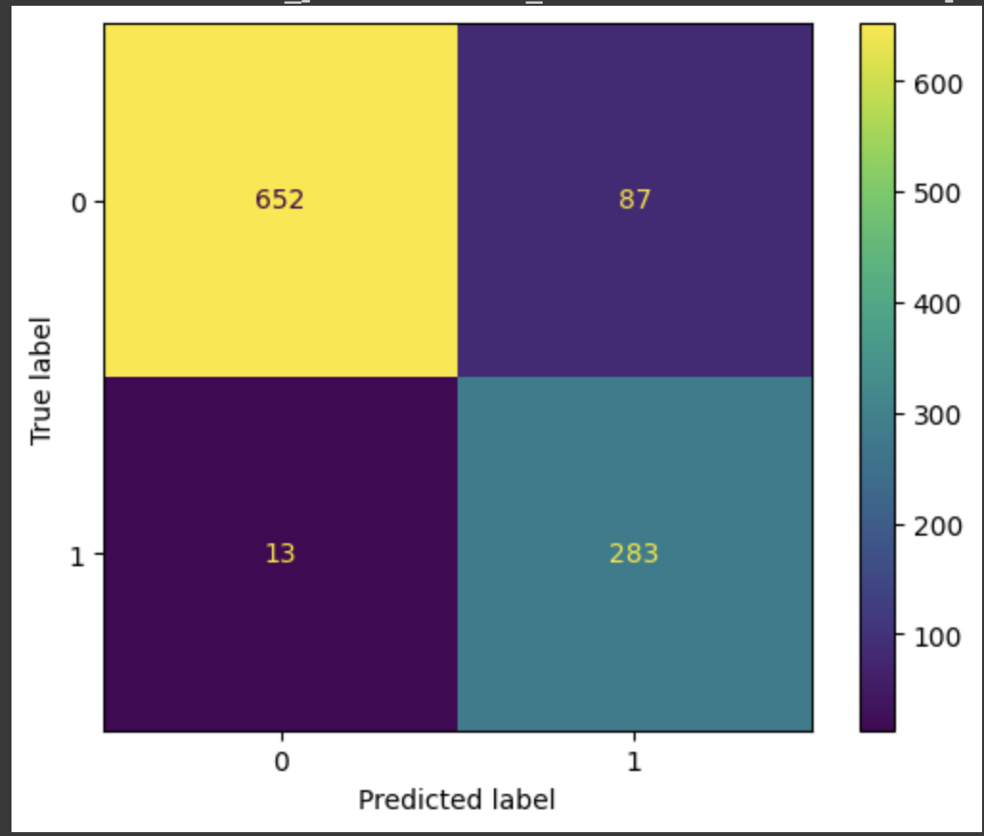
Results
Perceptron
Gets lowest training accuracy
Training set accuracy: 0.893
Testing set accuracy: 0.903
Not overfitted
It’s missing 87 out of 301 spam emails in the testing set
It doesn’t falsely label normal emails as spam very often, though

Slide 7

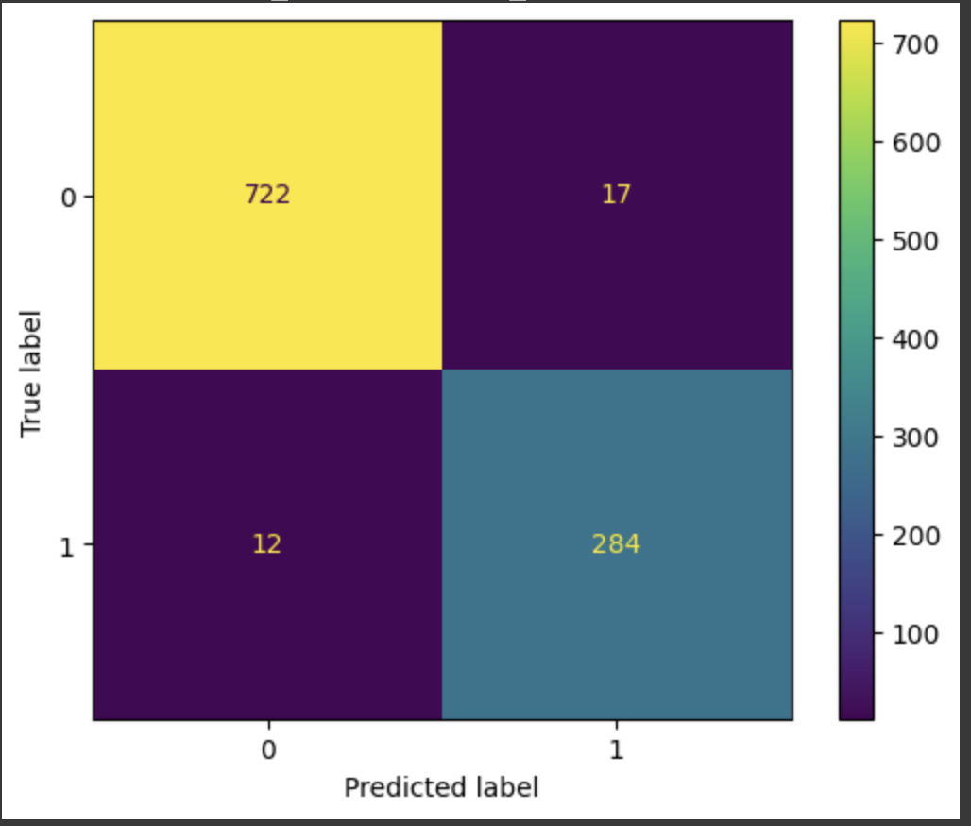
Results
Logistic Regression
C=1 gets highest training accuracy
Nearly 100%
Training set accuracy: 0.9995
Testing set accuracy: 0.971
Best training and testing accuracy
Slightly overfitted, but not by much

Slide 8
Conclusion
Logistic Regression (C=1, max_iter=1000) is the most effective algorithm for predicting spam email content based on this dataset
This algorithm can provide very reliable spam detection and potentially prevent users from falling victim to phishing and spoofing attacks
The machine learning concepts used in this project can be applied to real-world problems to create effective solutions

Slide 9
Future Work
The dataset used had already tokenized and given word counts for each email
I’d like to give the program the functionality to do this for a dataset containing just the text of the email and the label
This would involve doing extra pre-processing, but I would be able to use a wider range of datasets to further test my algorithms
Single email predictions
I’d like to make a function that will scan a single email for spam
In case someone is suspicious of a specific email, they could paste it into the program to test it on my algorithm

